Slide 1
DATA INTERPRETATION

Slide 2

1 = 100%
1/2 = 50%
1/3 = 33.33%
1/4 = 25%
1/5 = 20%
1/6 = 16.66%
1/7 = 14.28%
1/8 = 12.5%
1/9 = 11.11%
1/10 = 10%
1/11 = 9.09%

Slide 3
Ex 1: Marks scored by A is 50 and marks scored by B is 40. Then (i) A is what % more than B? (ii) B is what % less than A? (iii) A is what % of B? (iv) B is what % of A?

Slide 4
TABLE CHART (SET – 1)

Slide 5
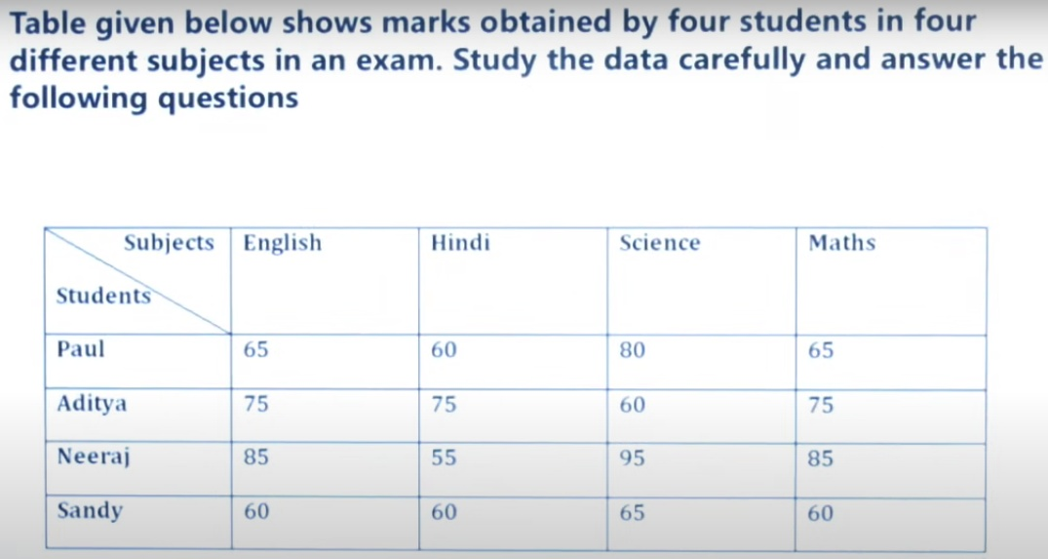
Marks scored by Sandy in English and Maths together is what percent of the Marks scored by Aditya and Neeraj in English together.
a) 25% b) 50% c) 75% d)100% e)80%

Slide 6
Find the ratio of total marks scored by all four students together in Hindi to total marks scored by all four students together in Science.
a) 5 : 6 b) 6 : 5 c) 1 : 1 d)57 : 50

Slide 7
Total marks scored by Paul are how much more/less than total marks scored by Neeraj?
a) 70 b) 60 c) 40 d)50

Slide 8
If maximum marks for each subject are 100 then find what percentage of total marks is obtained by Sandy.
a) 64.25% b) 61.25% c) 67.25% d)70.25%

Slide 9
LINE GRAPH (SET – 2)

Slide 10
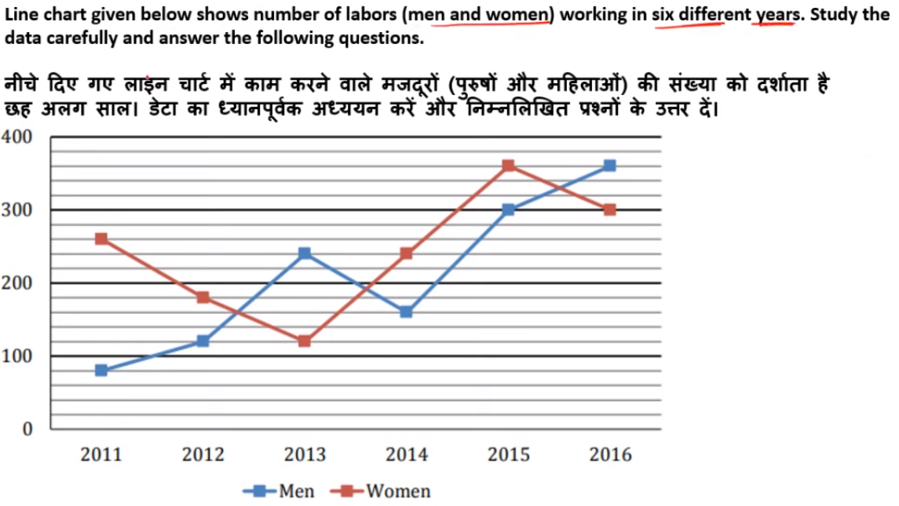

Slide 11
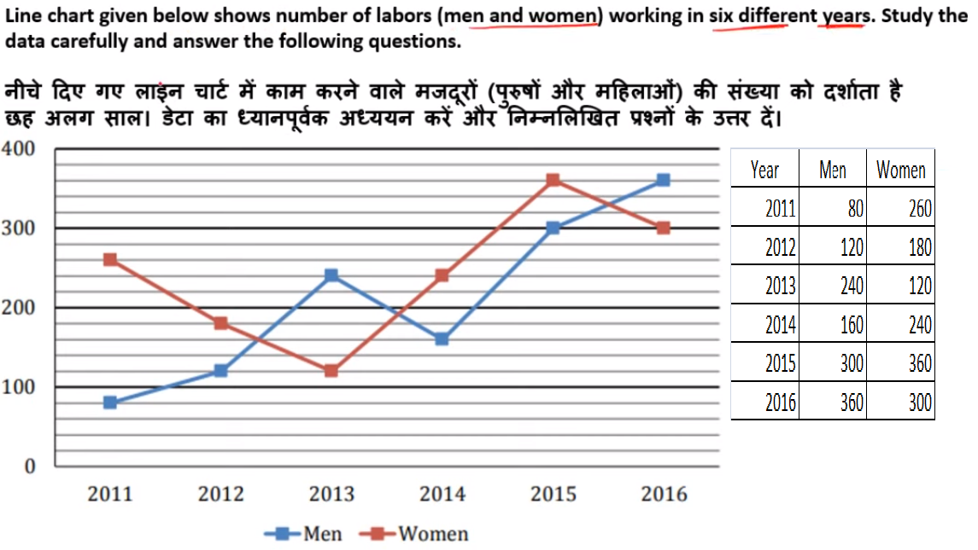
Number of men working in 2017 is 15% more than that of 2015 while number of women working in 2017 is 40% less than that of 2014. Find total number of labors (Men + Women) working in 2017?
A) 345 b) 144 c) 489 d) 459

Slide 12
Total number of Men working in 2012 and 2013 together is what percent of the total number of labors working in 2015?
A) 11% b) 9.09% c) 66.66% d) 54.5%

Slide 13
Average number of women working in 2014, 2015 and 2016 together is how much percent more/less than average number of Men working in 2011, 2014 and 2016 together?

Slide 14
Find the ratio between total number of labors working in 2012 and 2013 together to total number of labors working in 2015 and 2016 together?
A) 1:1 b) 1:2 c) 2:1 d) 3:4

Slide 15
Total number of men working in all six years is how much percent more/less than total number of women working in all six years together.

Slide 16
PIE CHART (SET – 3)

Slide 17
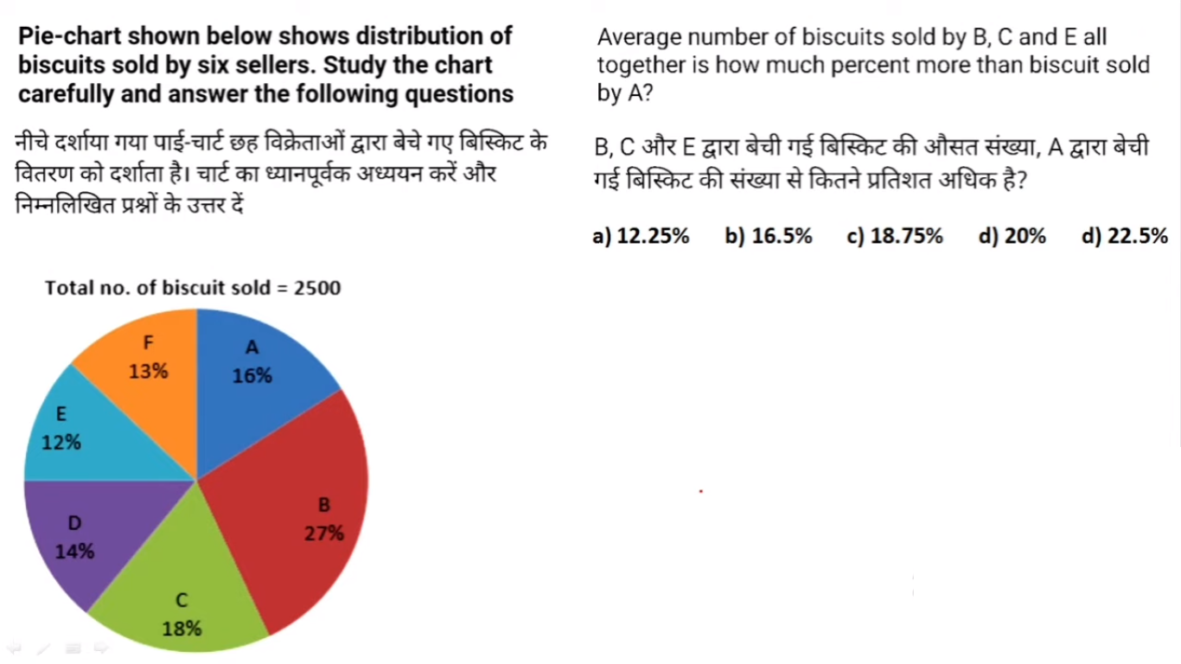

Slide 18
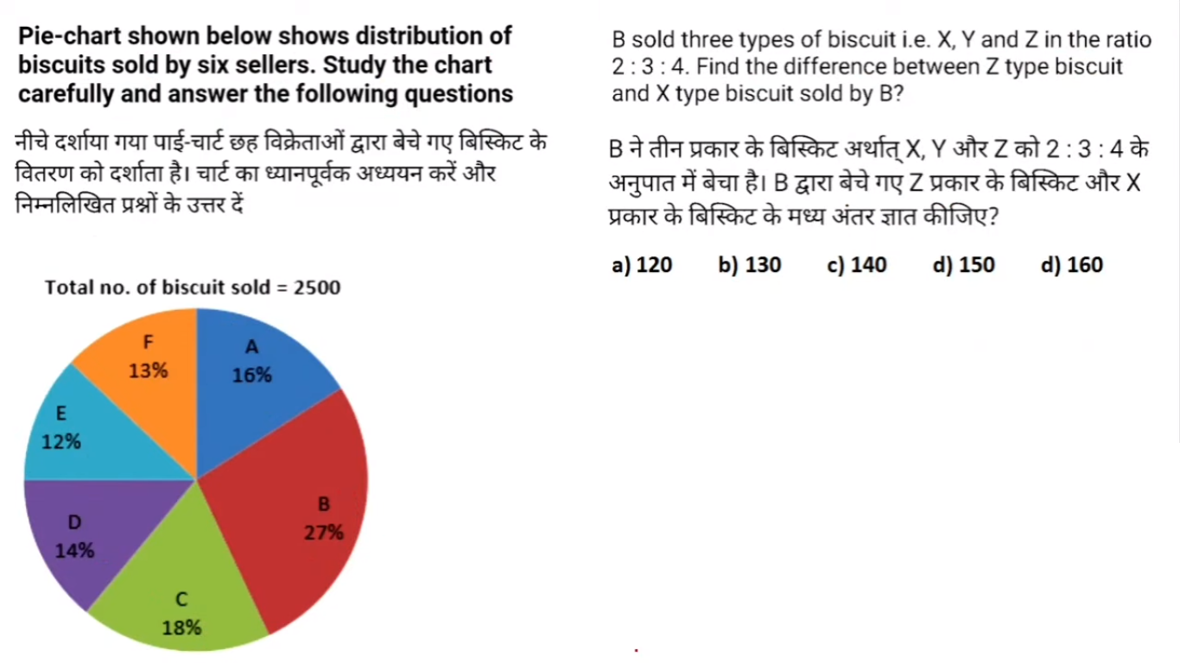

Slide 19


Slide 20


Slide 21
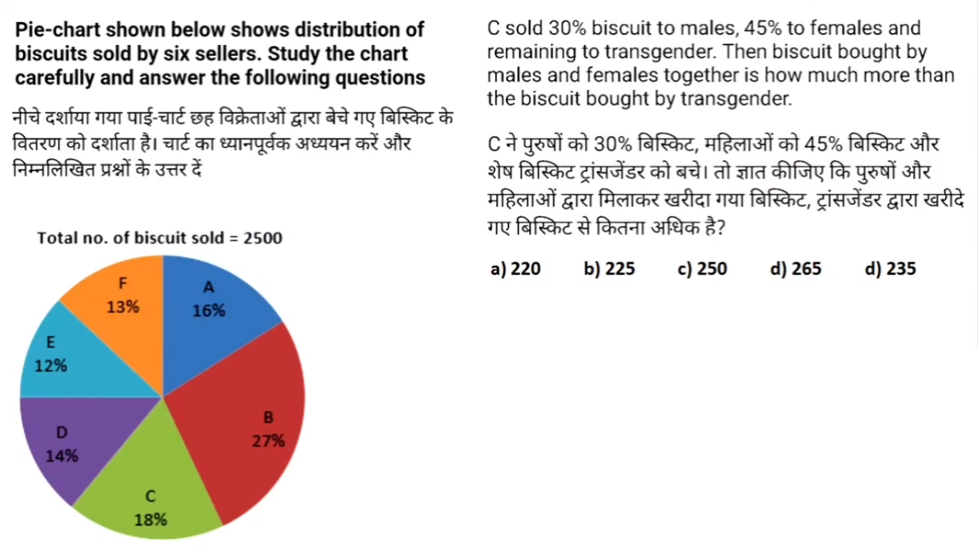

Slide 22
BAR GRAPH (SET - 4)

Slide 23
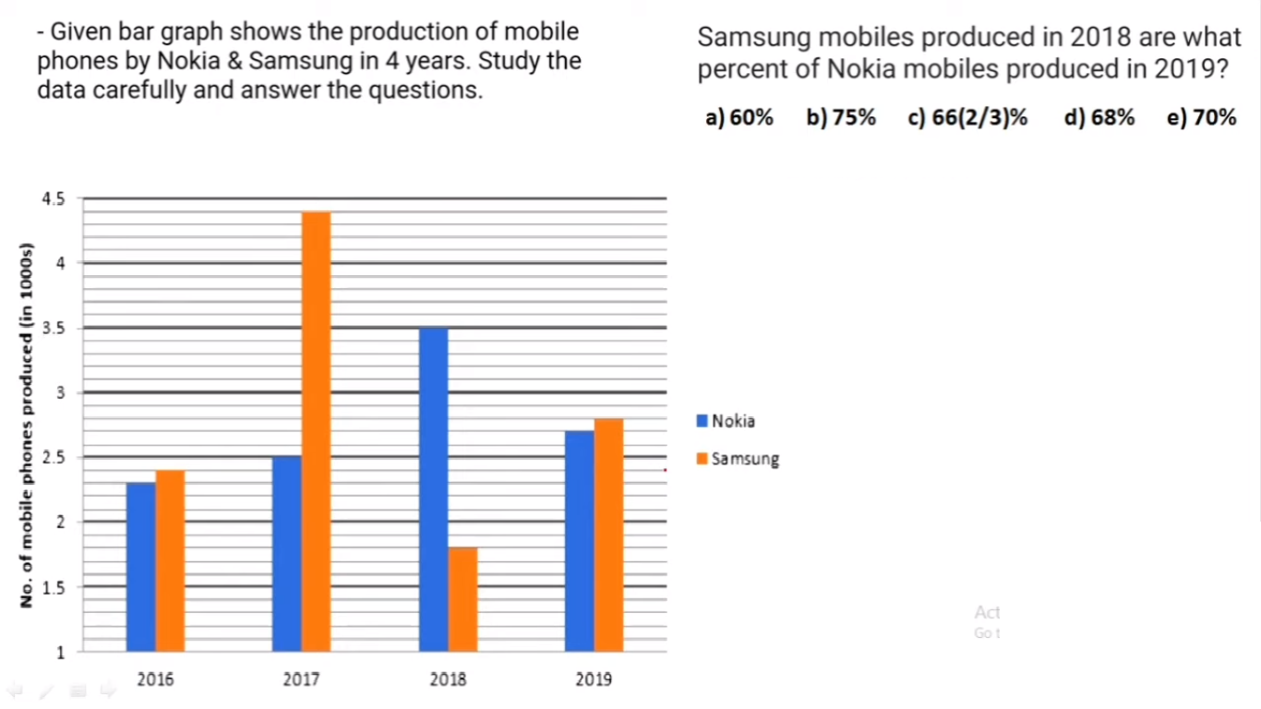

Slide 24
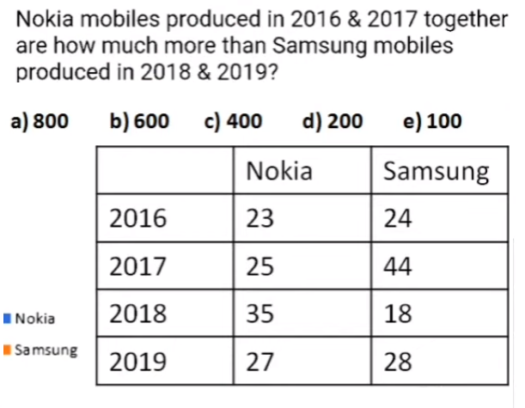

Slide 25
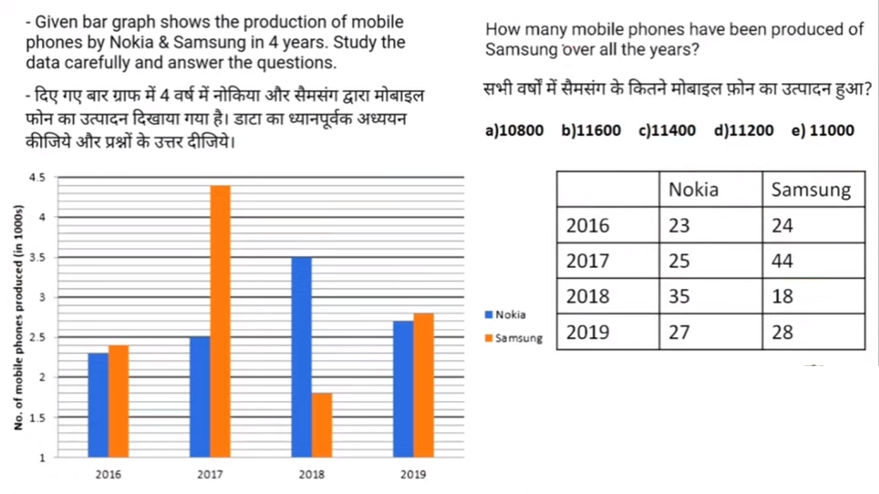

Slide 26
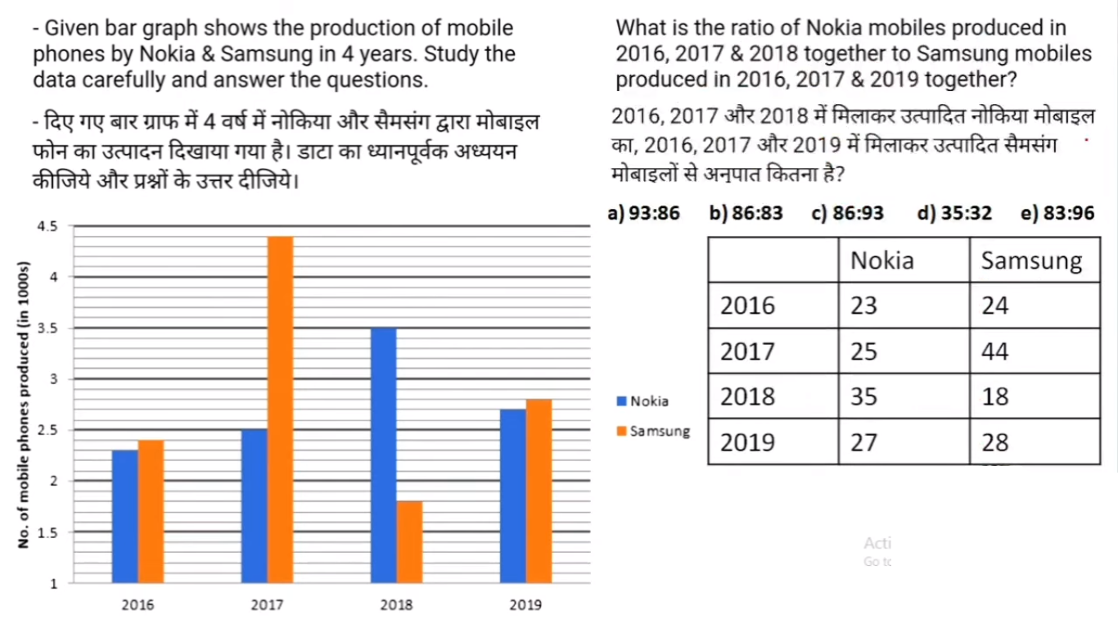

Slide 27
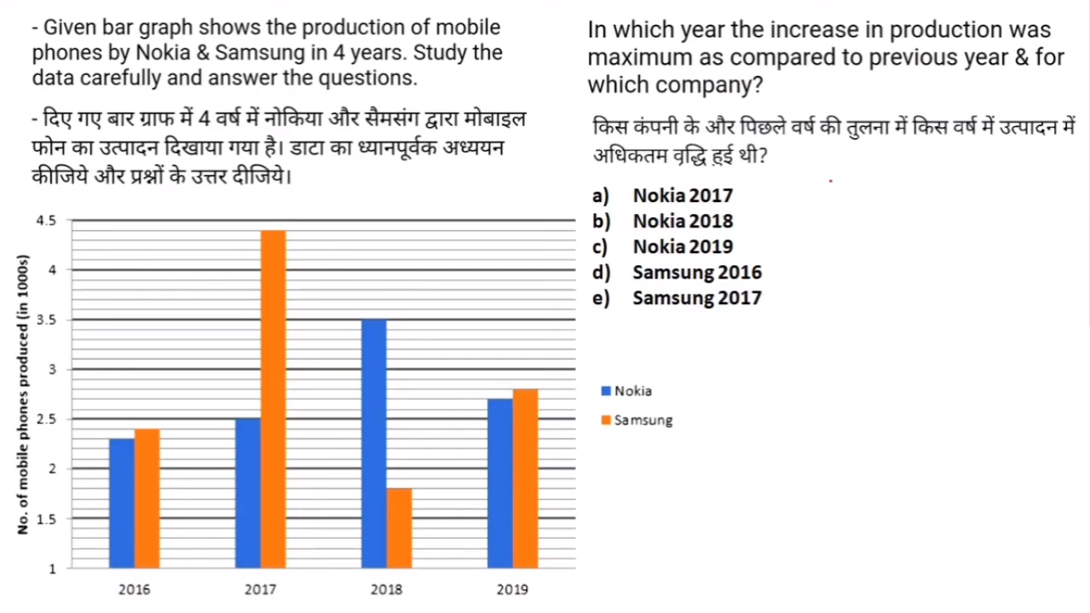

Slide 28
MIX DI (PI and Table) (SET – 5)

Slide 29
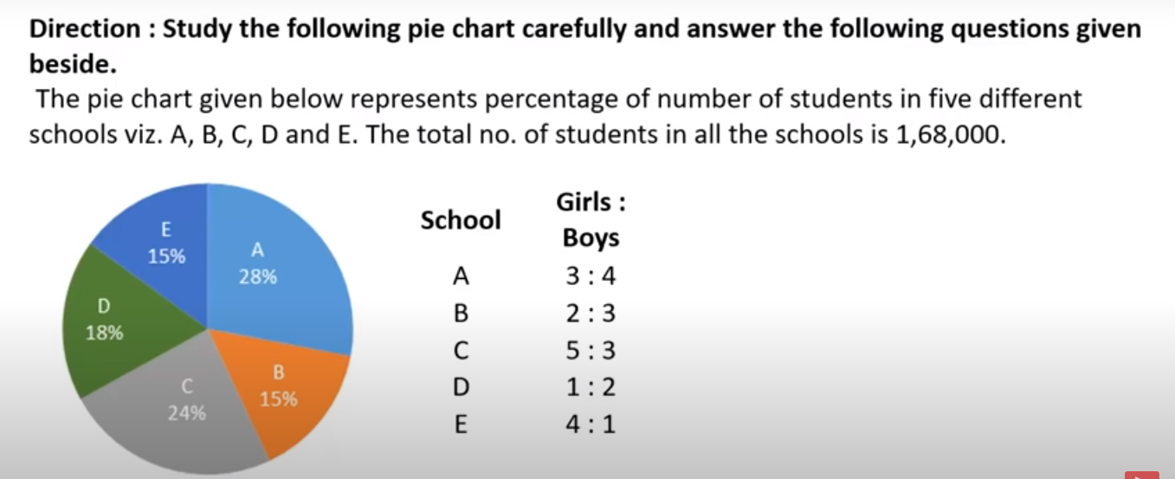

Slide 30
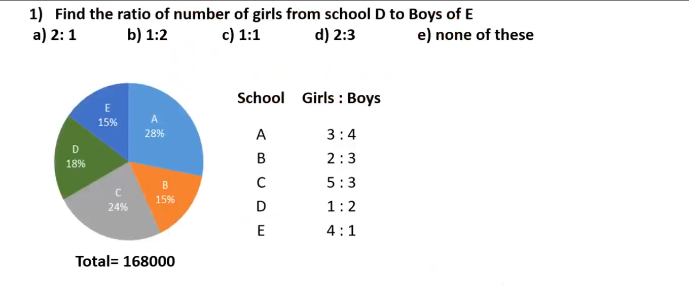

Slide 31
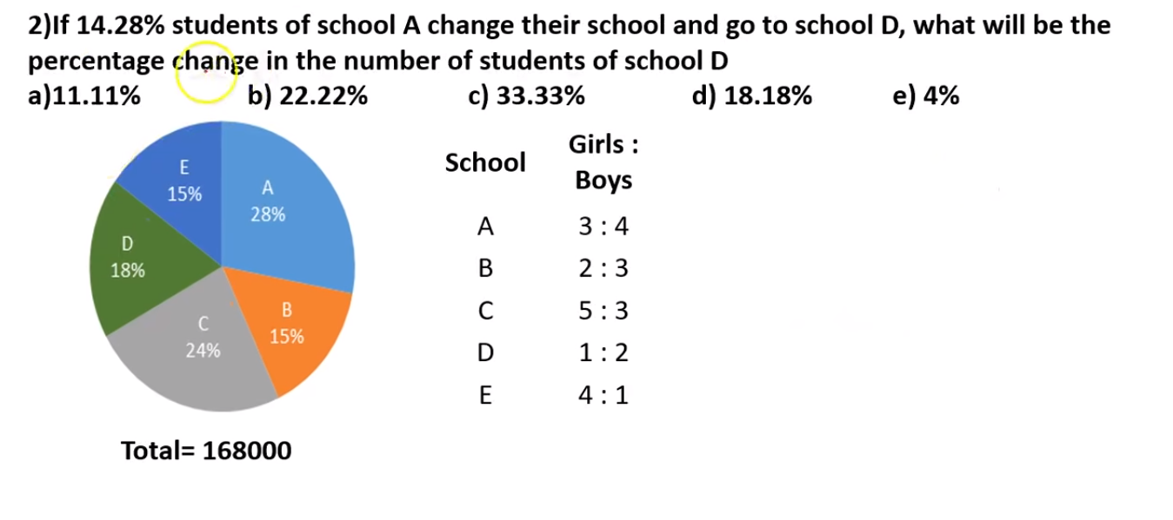

Slide 32
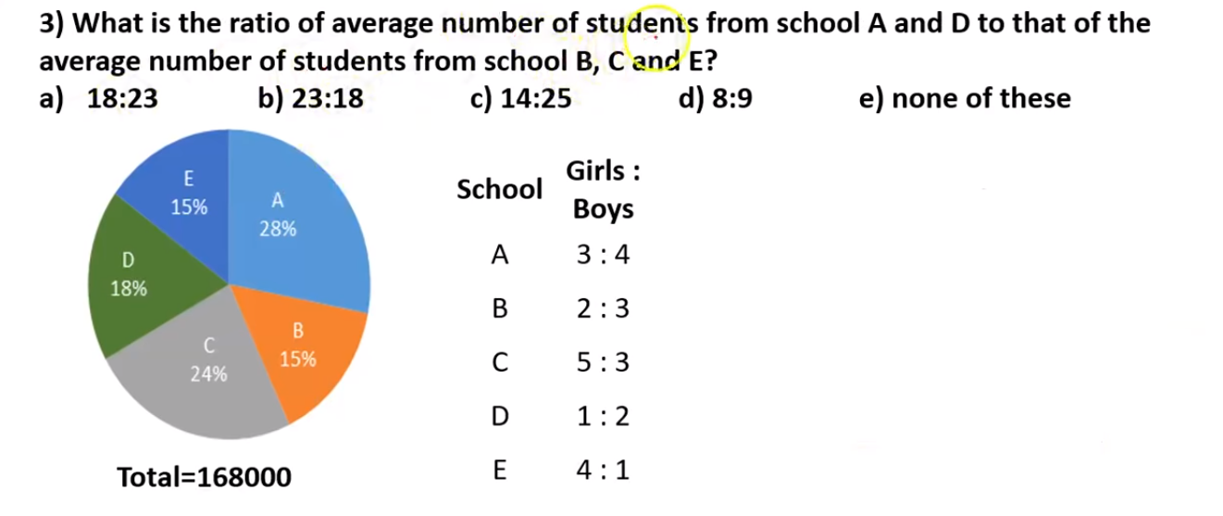

Slide 33
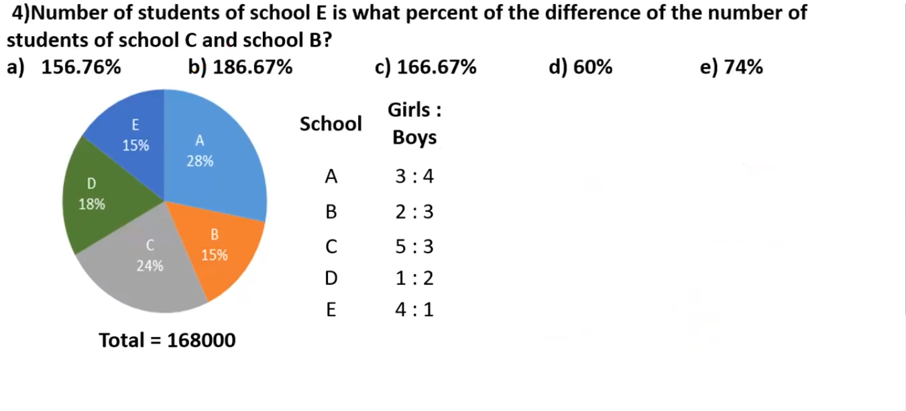

Slide 34
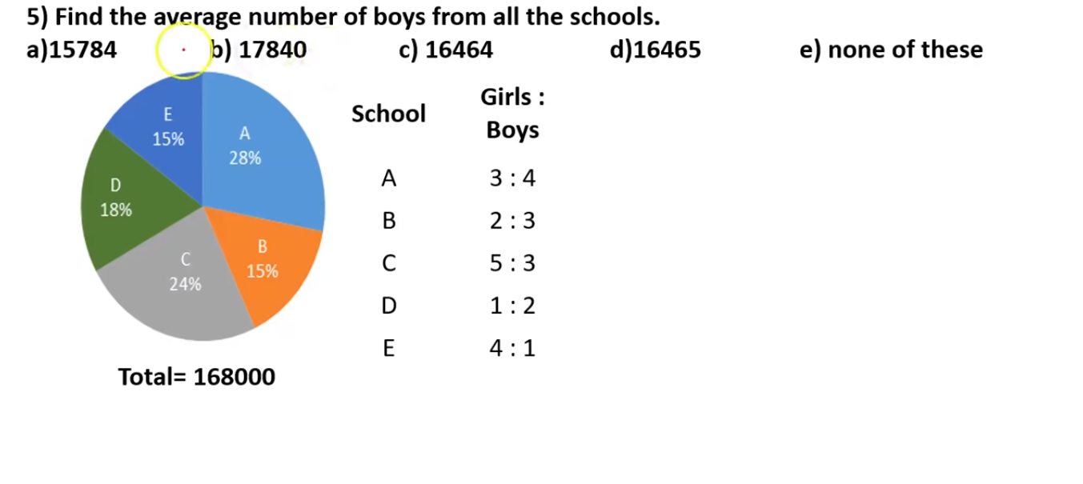

Slide 35
MIX DI (Line and Table) (SET – 6)

Slide 36
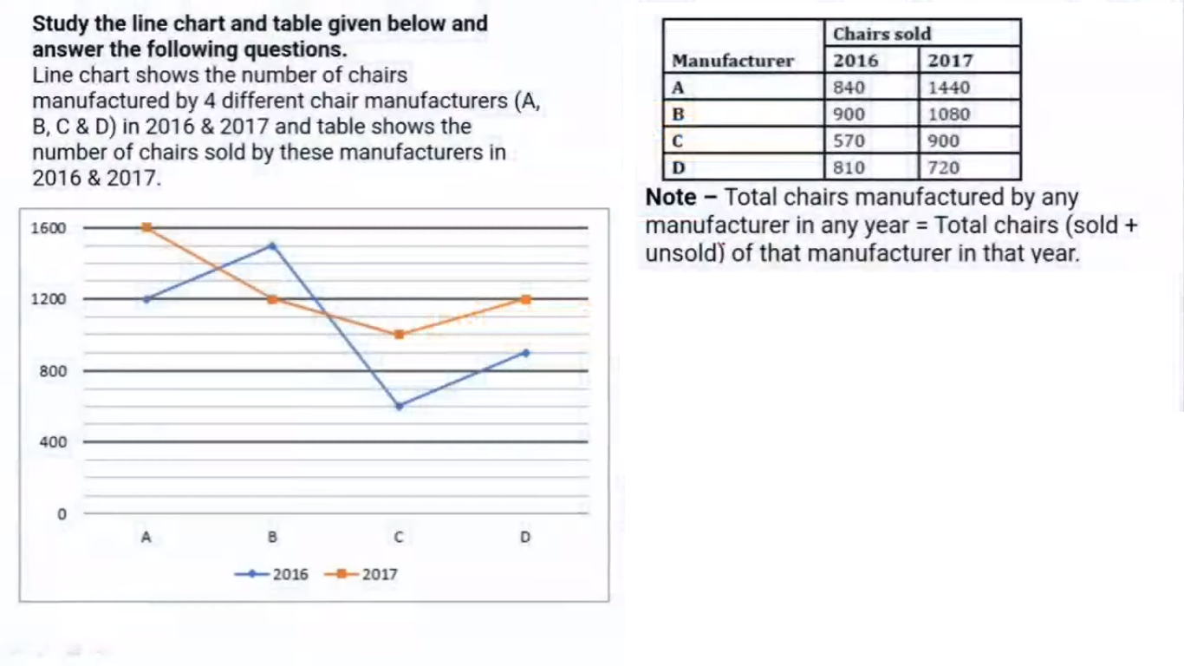
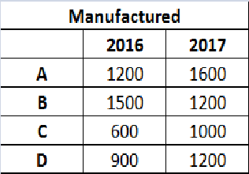

Slide 37
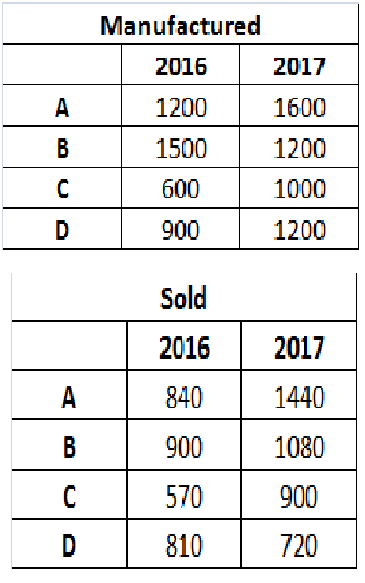
Unsold Chairs of A and D together in 2016 are what percent of sold chairs of B & D together in 2017?
75% b) 40%
c) 25% d) 55% e) 60%

Slide 38
Find ratio of chairs manufactured by A & C together in 2016 to chairs sold by C & D together in 2017?
a) 7:5 b) 11:12 c) 12:7 d) 10:9 e) 5:3

Slide 39
Find average number of chairs sold by A, B, C & D in 2016 is how much more/less than total unsold chairs of A,B,C & D together in 2017?
a) 80 b) 160 c) 350 d) 190 e) 270

Slide 40
If chairs manufactured by A in 2018 are 50% more than chairs sold by B in 2016 and ratio of sold to unsold chairs of A in 2018 is 2:1, then find average of chairs sold by A in 2016, 2017 & 2018.
a) 1350 b) 450 c) 900 d) 1060 e) 3180

Slide 41
SET - 7

Slide 42
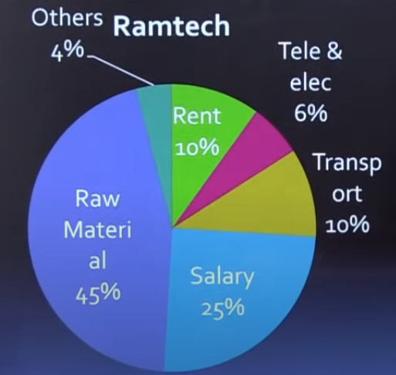
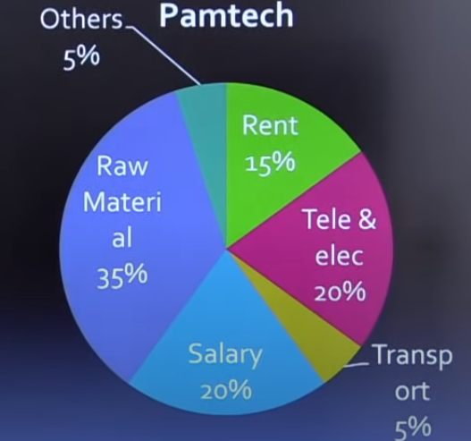
Following pie-chart shows the annual expenditure of two private companies.
Total: 40 crore
Total: 50 crore
The amount spent on Transport by Pamtech is what percentage of the amount spent by Ramtech on Transport?
a) 20 b) 30 c) 40 d)50

Slide 43
Following pie-chart shows the annual expenditure of two private companies.
Total: 40 crore
Total: 50 crore
The expenditure on Ramtech’s Rent is how much percentage less than the Pamtech’s Rent?
a) 33.33 b) 16.66 c) 20 d)25

Slide 44
Following pie-chart shows the annual expenditure of two private companies.
Total: 40 crore
Total: 50 crore
The expenditure on raw material for both campany taken together is approx what percentage of the total expenditure?
a) 20 b) 30 c) 40 d)50

Slide 45
SET - 8

Slide 46
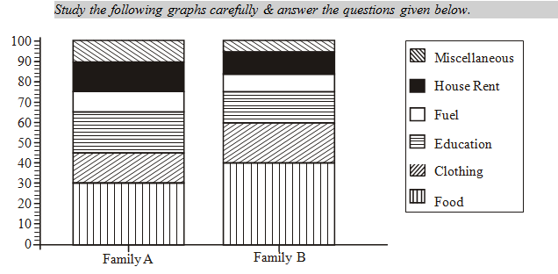
What fraction of the total expenditure is spent on education in family A ?
(a) 13/21 (b) 2/3 (c) 9/13 (d) 1/5

Slide 47
If the total expenditure on family B is Rs 10000, then money spent on clothes by this family during the year is
(a) Rs 200(b) Rs 600 (c) Rs 2000 (d) Rs 6000

Slide 48
If the total annual expenditure of family A is Rs 30000, the money spent on food, clothes and house rent is
(a) Rs 18500 (b) Rs 18000(c) Rs 21000(d) Rs 15000

Slide 49
If both the families have the same expenditure, which one spends more on education and miscellaneous together ?
(a) A (b) B
(c) Both spends equal amount (d) Data inadequate

Slide 50
What percentage is B’s expenditure on food over A’s expenditure on food, taking equal total expenditure ?
(a) 10% (b) 70% (c) 133.33% (d) 75%

Slide 51
SET - 9

Slide 52
The table below shows the number of new volunteers who joined different NGO’s. Prayas, Paribhasa, Abhyas and Aatam Nirbhar which have been running from 2015. As per the rule, a person who has joined one NGO cannot join any other NGO at the same time.
What is the percentage increase in total new volunteers who joined in 2020 to total new volunteers who had joined in 2018 for all the four NGO’s combined?
24% b) 26% c) 34% d) 36%

Slide 53
The table below shows the number of new volunteers who joined different NGO’s. Prayas, Paribhasa, Abhyas and Aatam Nirbhar which have been running from 2015. As per the rule, a person who has joined one NGO cannot join any other NGO at the same time.
Which NGO showed the highest growth rate in the number of new volunteers who joined from 2018 to 2020 ?
Prayas b) Paribhasa c) Abhyas d) Aatam Nirbhar

Slide 54
The table below shows the number of new volunteers who joined different NGO’s. Prayas, Paribhasa, Abhyas and Aatam Nirbhar which have been running from 2015. As per the rule, a person who has joined one NGO cannot join any other NGO at the same time.
The total number of new volunteers who joined Aatam Nirbhar from 2018 to 2020 is what percent more than the average number of new volunteers who joined Paribhasha during the same period of time?
40% b) 45% c) 50% d) 100%

Slide 55
The table below shows the number of new volunteers who joined different NGO’s. Prayas, Paribhasa, Abhyas and Aatam Nirbhar which have been running from 2015. As per the rule, a person who has joined one NGO cannot join any other NGO at the same time.
If average number of hours for which the volunteers at Paribhasa worked was 2 hours more than the average number of hours for which the volunteers at Abhyas worked . Then how many number of hours volunteers at Paribhasa worked more than the volunteers at Abhyas in 2020 ?
10 hours b) 110 hours c) 100 hours d) cannot be determined

Slide 56
SET - 10

Slide 57
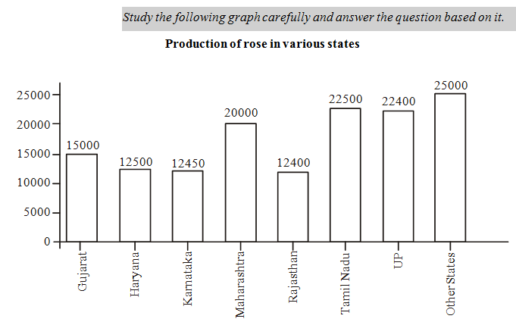
Which of the following state(s) contribute(s) less than 10 per cent in the total rose production ?
(a) Only Rajasthan (b) Rajasthan, Karnataka
(c) Rajasthan, Karnataka, Haryana
(d) Rajasthan, karnataka, Haryana and Gujarat

Slide 58
By what percentage rose production of other states is more than that of the Maharashtra ? (a) 25 (b) 30 (c) 20 (d) 15

Slide 59
What is the approximate average production of roses (in thousands) across all the states ?
(a) 21 (b) 20 (c) 19 (d) 18

Slide 60
Approximately what percentage of the total rose producation is shared by the other states
(a) 10 (b) 20 (c) 30 (d) 40

Slide 61
If total percentage contribution of the states having production of roses below twenty thousand is considered, which of the following statements is true ?
(a) It is little above 40% (b) If is exactly 35%
It is below 35% (d) None of these

Slide 62
SET - 11

Slide 63
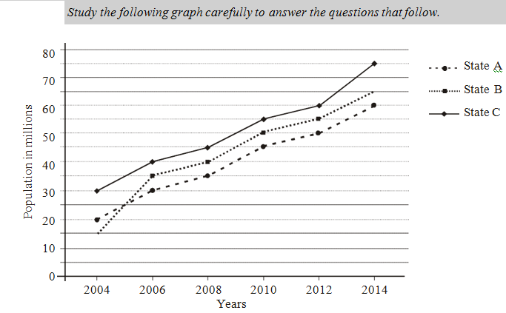
In which of the following years was the percentage increase in population of State ‘A’ from the preceding (given) year the maximum ?
(a) 2006 (b) 2008 (c) 2010 (d) 2012

Slide 64
What was the average population of state ‘C’ for all the given years (in millions) ?
(a) 50 (5/6) (b) 60 (2/3) (c) 55 (3/5)
(d) 62 (3/5)

Slide 65
What is the ratio of the average population of three states in 2004 to that in 2008 ?
(a) 1 : 2 (b) 2 : 3 (c) 12 : 23 (d) 13 : 24

Slide 66
What was the ratio of average population of state ‘B’ for 2006, 2008 and 2010 to that of state ‘C’ for these three years ?
(a) 5 : 7 (b) 25 : 28 (c) 7 : 9 (d) 15 : 19

Slide 67
What is the percentage increase in total population of the three states from 2010 to 2014 ?
(a) 30(2/3) (b) 30(1/3) (c) 33(2/3) (d) 33(1/3)

Slide 68
THANK YOU

